Slide 1

System Administration
Microsoft Exchange Server 2013
6th System Apparent Group
Notes:
Drag & Drop to add a picture in the back placeholder

Slide 2
Contents
01
02
03
04
05
Exchange Server 2013 Definitions and Features
Exchange Server 2013 Installation and Configuration
Client Access
Certificate
Customization
Notes:
Drag & Drop to add a picture in the back placeholder

Slide 3

Microsoft Exchange Server - Definition
01
Is a mail server and calendaring server developed by Microsoft.
The first version was called Exchange Server 4.0, to position it as the successor to the related Microsoft Mail.
Exchange initially used the X.400 directory service but switched to Active Directory later.
Runs exclusively on Windows Server operating systems.
It integrates with other Microsoft products, such as Outlook and SharePoint, to create a unified communication environment
Primarily uses a proprietary protocol called MAPI , for POP3, IMAP, and EAS1 to talk to email clients
The standard SMTP protocol is used to communicate to other Internet mail servers.
Notes:
Drag & Drop to add a picture in the placeholder

Slide 4

Features and Characteristics Of Exchange Server.
02
Email: Exchange Server provides a robust email infrastructure with features such as message encryption, message tracking, and customizable policies for email retention and archiving.
Calendar and Scheduling: It offers advanced calendar management, allowing users to schedule meetings, appointments, and events, and facilitates easy sharing of calendars within the organization.
Contacts and Address Book: Exchange Server includes a comprehensive contact management system, enabling users to create, organize, and share contact information seamlessly.
Task Management: The platform supports the organization and management of tasks and projects with features for task creation, assignment, tracking, and collaboration.
Mobile Device Support: Exchange Server offers synchronization and access to emails, calendars, and contacts on a wide range of mobile devices, ensuring connectivity on the go.
Notes:
Drag & Drop to add a picture in the placeholder

Slide 5

Features And Characteristics of Exchange Server
03
Unified Messaging: Exchange Server integrates voicemail, email, and fax messaging into users' inboxes, providing a unified experience across various communication channels.
Collaboration Tools: The platform offers shared mailboxes, public folders, and the ability to collaborate on documents, fostering teamwork and productivity within the organization.
Notes:
Drag & Drop to add a picture in the placeholder

Slide 6
Features And Characteristics of Exchange Server
04
Scalability: Exchange Server is designed to scale from small businesses to large enterprises, accommodating a growing number of users and mailboxes.
High Availability: It offers features for high availability and fault tolerance, ensuring that email services remain accessible even in the event of server or network failures.
Performance Optimization: The platform is engineered for high performance and reliability, supporting efficient email delivery, search, and data retrieval.
Intuitive Integration with Outlook: Exchange Server integrates seamlessly with Microsoft Outlook, providing a rich email and calendaring experience for users.
Customization and Extensibility: It allows customization through the development of add-ins, extensions, and third-party integrations to tailor the messaging environment to organizational needs.
Security and Data Protection: Exchange Server offers robust security measures, including role-based access control, anti-malware protection, and message hygiene, to ensure the confidentiality and integrity of organizational communications.
Notes:
Drag & Drop to add a picture in the placeholder

Slide 7

Exchange Server 2013 Installation
05
Prerequisite:
Active Directory Preparation
Window Server 2012 operating system.
Installing and Configuring the ADDS
Installing and Configuring another ADDS and replicate to install exchange server.
Exchange Server
Operating System - Window Server 2012
Associated Server Roles:
1. Mailbox Server Role.
2. Client Access Server Roles.
Notes:
Drag & Drop to add a picture in the placeholder

Slide 8

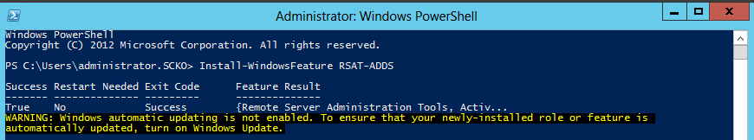
Exchange Server 2013 Installation Steps
06
Powershell Command:
Install-WindowsFeature RSAT-ADDS
Notes:
Drag & Drop to add a picture in the placeholder

Slide 9

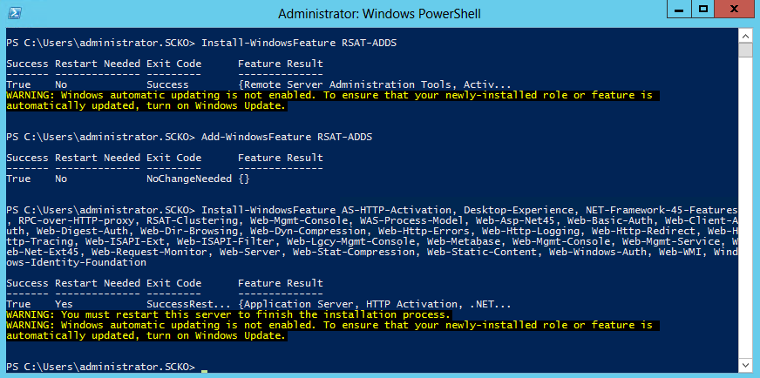
Exchange Server 2013 Installation Steps
07
2. Windows Server 2012 prerequisites for Mailbox Server Role
3. Windows Server 2012 prerequisites for standalone Mailbox Server Role or Mailbox and Client Access Server role
Notes:
Drag & Drop to add a picture in the placeholder

Slide 10
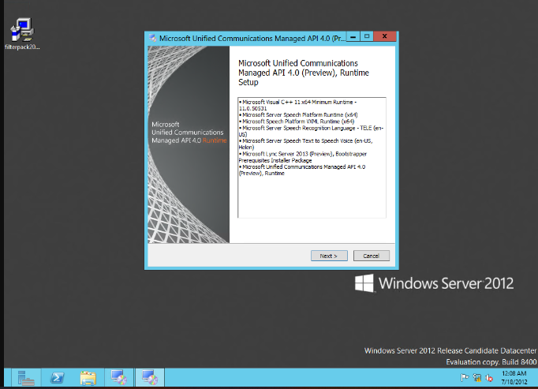
Exchange Server 2013 Installation Steps
08
4. Download and Install the Microsoft Unified Communications Managed API 4.0, Core Runtime 64-bit software.
Notes:
Drag & Drop to add a picture in the placeholder

Slide 11
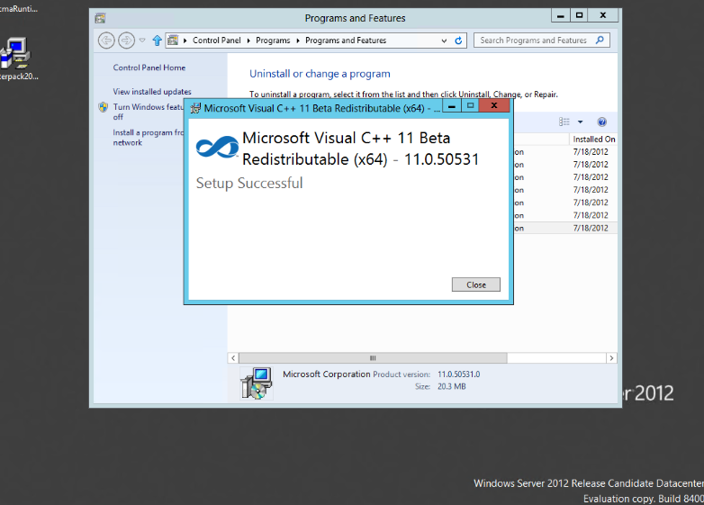
Exchange Server 2013 Installation Steps
09
5. For Exchange Server 2013 preview, Microsoft Visual C++ 11 beta redistributable (x64) component should be removed from the system.
Notes:
Drag & Drop to add a picture in the placeholder

Slide 12
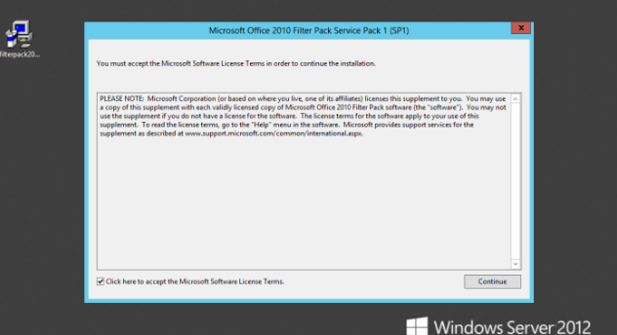
Exchange Server 2013 Installation Steps
10
6. Uninstall Visual C++ 11 Beta Redistributable (x64) – 11.0.50531
7. Uninstall the Microsoft Visual C++ 11 Beta setup,
8. Download and Install the Microsoft Office 2010 Filter Pack 64 bit software.
9. Download and Install the Microsoft Office 2010 Filter Pack SP1 64 bit.
Notes:
Drag & Drop to add a picture in the placeholder

Slide 13
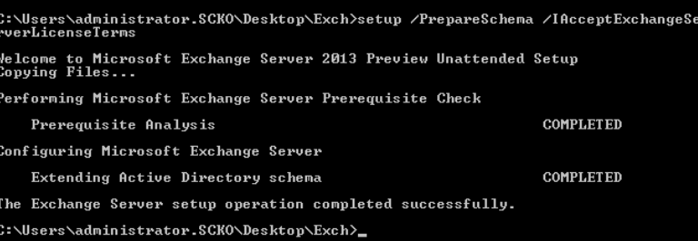
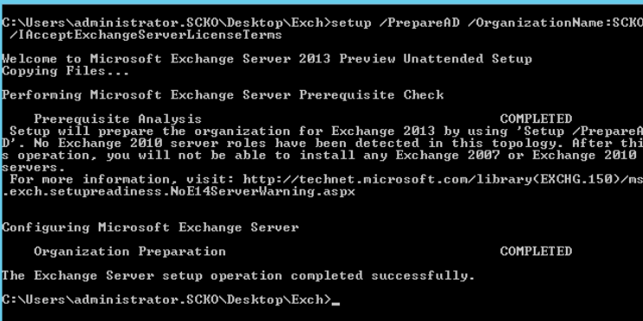
Exchange Server 2013 Installation Steps
11
10. Prepare Active Directory and domains.
To execute the commands, the commands should be run using the Schema Admins group and the Enterprise Admins group membership
setup /PrepareSchema /IAcceptExchangeServerLicenseTerms
setup /PrepareAD /OrganizationName: /IAcceptExchangeServerLicenseTerms
Notes:
Drag & Drop to add a picture in the placeholder

Slide 14
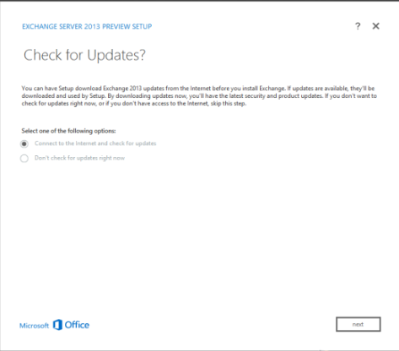
Exchange Server 2013 Installation Steps
12
11. Install Exchange Server 2013
Mount/Navigate to the Exchange Server 2013 Preview Installation Media.
Start Exchange 2013 Preview Setup by double-clicking Setup.exe
On the Check for Updates page, select whether you want Setup to connect to the Internet and download product and security updates for Exchange 2013 Preview and click Next.
Notes:
Drag & Drop to add a picture in the placeholder

Slide 15
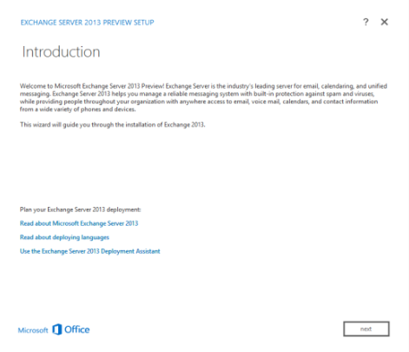
Exchange Server 2013 Installation Steps
13
Once the setup is finished copying files on the Copying File page, click Next
Notes:
Drag & Drop to add a picture in the placeholder

Slide 16
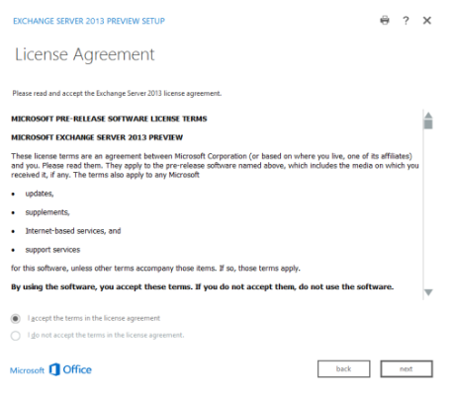
Exchange Server 2013 Installation Steps
14
On the License Agreement page, review the terms. If you agree to the terms, select I accept the terms in the license agreement, and then click next.
Notes:
Drag & Drop to add a picture in the placeholder

Slide 17
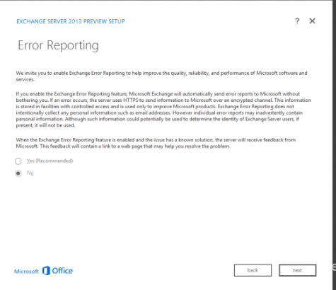
Exchange Server 2013 Installation Steps
15
On the Error Reporting page, select whether you want to enable or disable the Exchange Error Reporting feature, and then click next.
Notes:
Drag & Drop to add a picture in the placeholder

Slide 18
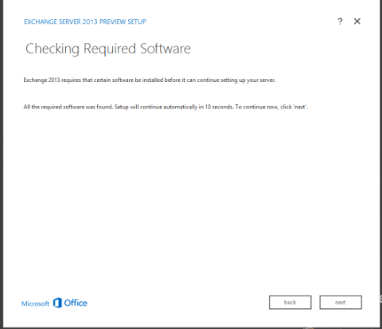
Exchange Server 2013 Installation Steps
16
On the Checking Required Software page, wait for the Setup to verify for prerequisite software checking to finish. If any applications are listed, install them and then run Setup again. If all required software is found, click next to continue.
Notes:
Drag & Drop to add a picture in the placeholder

Slide 19
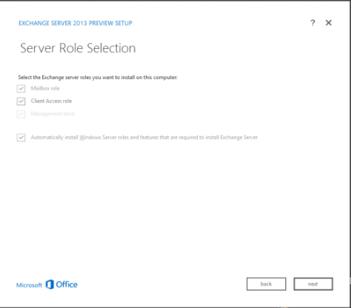
Exchange Server 2013 Installation Steps
17
On the Server Role Selection page, choose whether to install the Mailbox role, the Client Access role or both roles on the server. For this guide both server roles were installed.
Notes:
Drag & Drop to add a picture in the placeholder

Slide 20
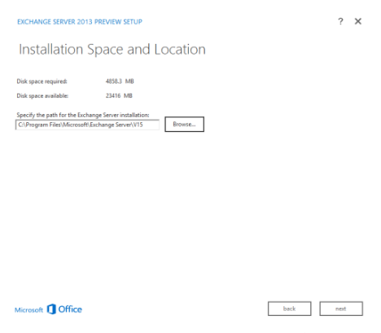
Exchange Server 2013 Installation Steps
On the Installation Space and Location page, either accept the default installation location or click Browse to choose a new location with adequate storage space.
Notes:
Drag & Drop to add a picture in the placeholder

Slide 21
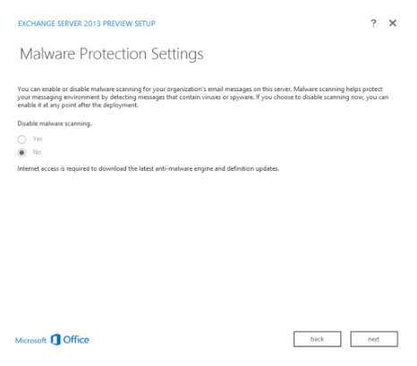
Exchange Server 2013 Installation Steps
19
One of the new features of Exchange 2013 preview is the Malware Protection. If installing the Mailbox role a Malware Protection Settings page will appear. Choose whether to enable or disable malware scanning and click Next.
Notes:
Drag & Drop to add a picture in the placeholder

Slide 22
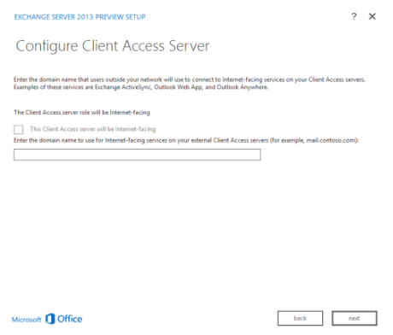
Exchange Server 2013 Installation Steps
20
If installing the Client Access server role, on the Configure Client Access Server external domain page, choose an option to suite your deployment. If selecting ‘This Client Access server will be Internet-facing if the Client Access server you’re installing will be accessible from the Internet’. Enter a domain name to use to configure your Client Access servers. If not, keep the space blank and click Next to proceed.
Notes:
Drag & Drop to add a picture in the placeholder

Slide 23
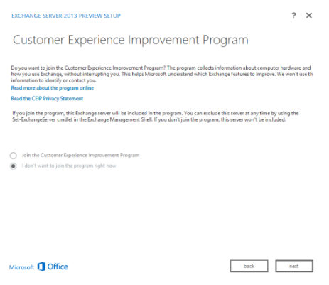
Exchange Server 2013 Installation Steps
21
On the Customer Experience Improvement Program page, choose an appropriate option, and then click Next to proceed.
Notes:
Drag & Drop to add a picture in the placeholder

Slide 24
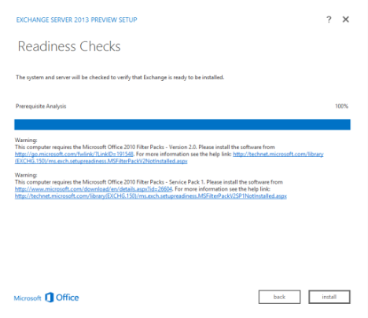
Exchange Server 2013 Installation Steps
22
On the Readiness Checks page, view the status to determine if the organization and server role prerequisite checks completed successfully.If unsuccessful, perform the required tasks and click Back, and Next to run the Readiness check again.If successful, click Next to proceed.
Notes:
Drag & Drop to add a picture in the placeholder

Slide 25
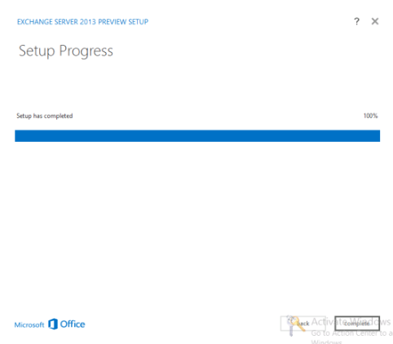
Exchange Server 2013 Installation Steps
23
The installation will be performed.
Once the setup completes the installation, on the Completion page, click Complete.
Restart the computer after Exchange 2013 Preview has completed.
Notes:
Drag & Drop to add a picture in the placeholder

Slide 26
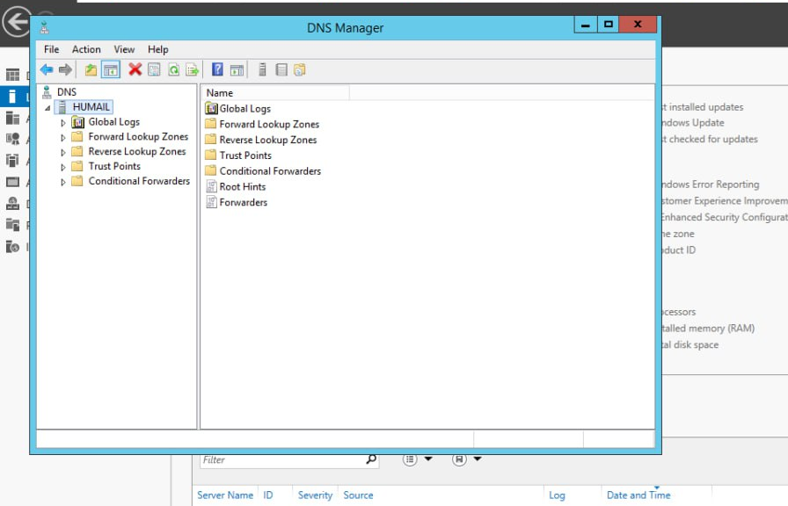
Client Access
24
INTERNAL AND EXTERNAL URL CREATION
First we go to Forward DNS lookup zone and we create domain name for our external and internal URL.
We create domain name called “mail” and we concatenate to our exchange domain
Notes:
Drag & Drop to add a picture in the placeholder

Slide 27
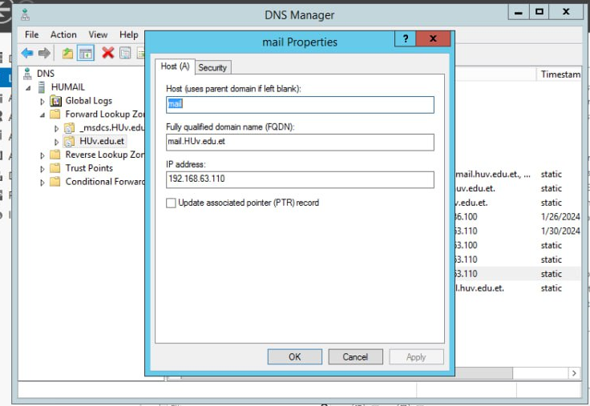
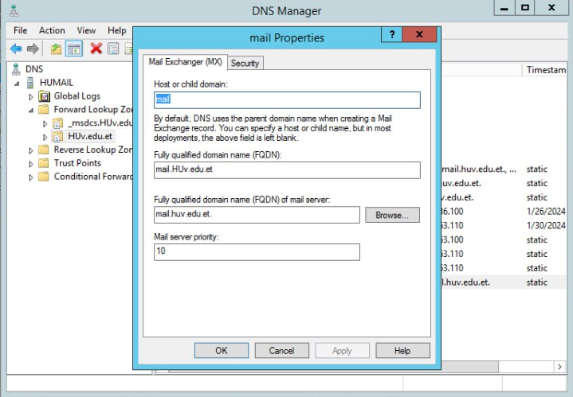
Client Access
25
Notes:
Drag & Drop to add a picture in the placeholder

Slide 28
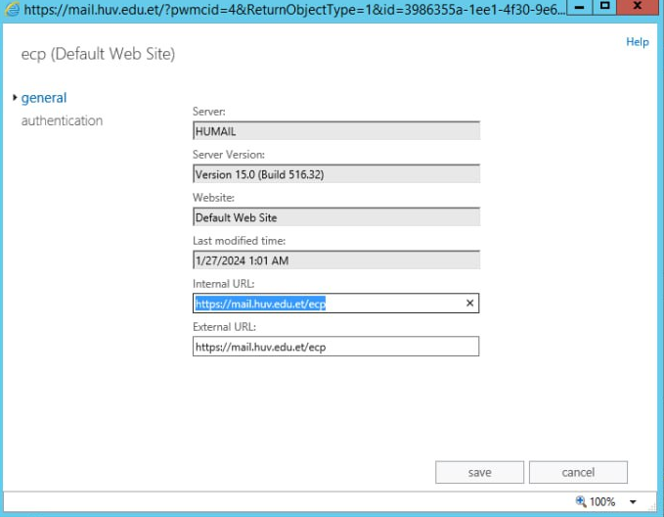
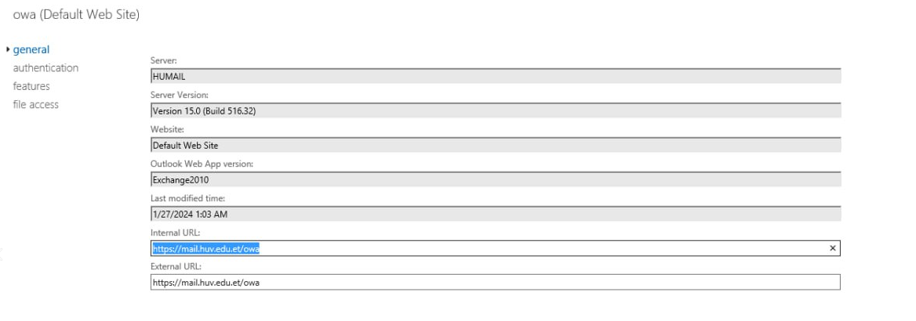
Client Access
26
now go to exchange server’s web ecp outlook and login as Administrator
And then change the External and Internal URL to the domain we created accordingly for both ecp and owa .
Notes:
Drag & Drop to add a picture in the placeholder

Slide 29
Client Access
27
Internal URL: is used to access the Exchange services from within the internal network.
External URL :is used to access the services from outside the network
I.e, Internal URL: https://mail.huv.edu.et/ecp
https://mail.huv.edu.et/owa
External URL:https://mail.huv.edu.et/ecp
https://mail.huv.edu.et/owa
Note: Internal URL and External URL may not be always the same.
Notes:
Drag & Drop to add a picture in the placeholder

Slide 30
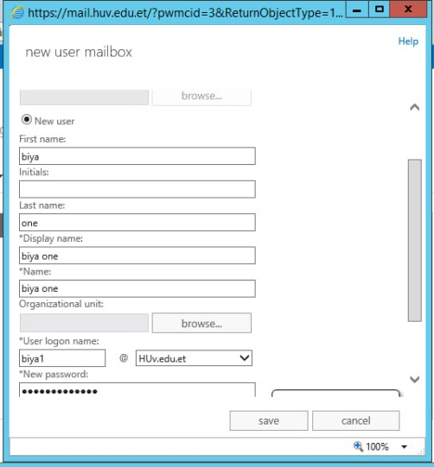
Client Access
28
Milbox user Account creation
Login as administrator to the ecp and then you create new user mailbox accordingly.
Notes:
Drag & Drop to add a picture in the placeholder

Slide 31
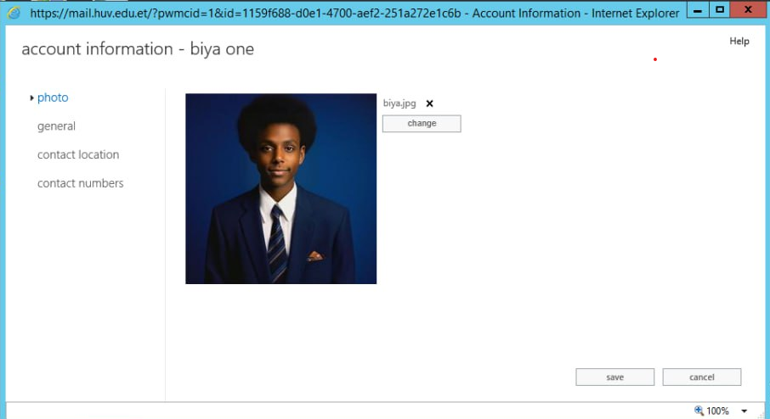
Client Access
29
Then we can login to the OWA with the account we create.
You can send and receive mails.
Notes:
Drag & Drop to add a picture in the placeholder

Slide 32
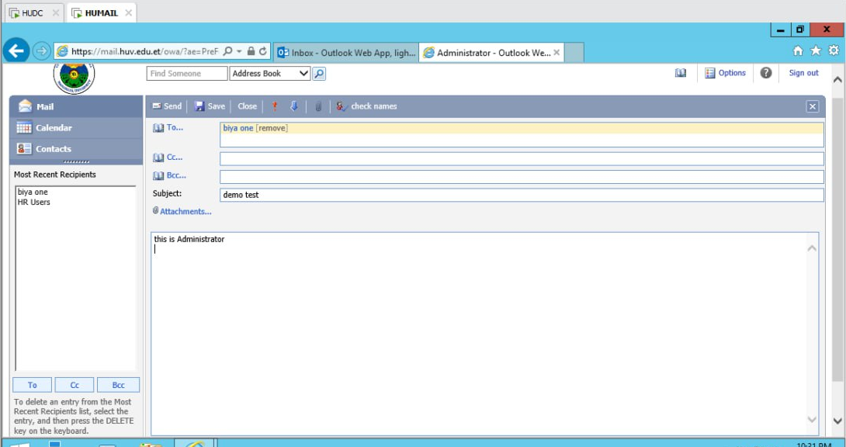
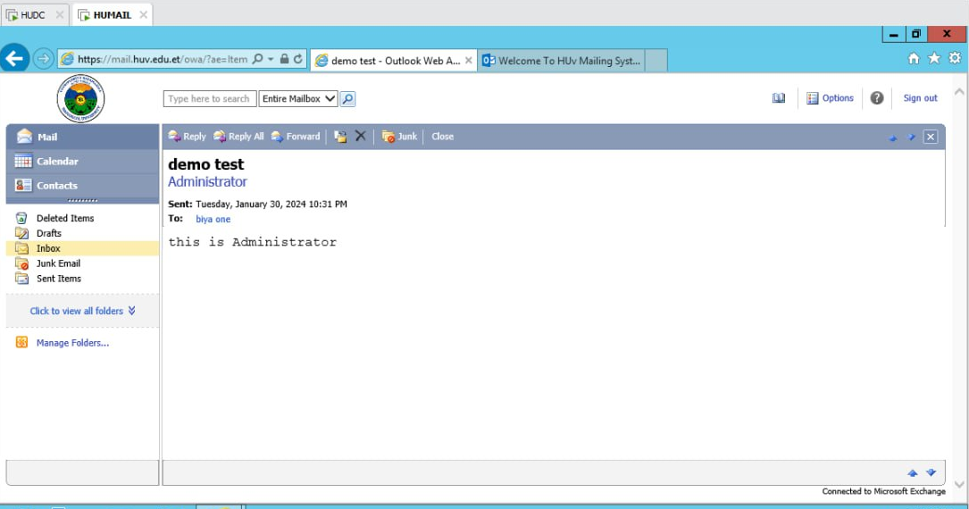
Client Access
30
Notes:
Drag & Drop to add a picture in the placeholder

Slide 33
Client Access
31
Calendaring
calendaring refers to the features and functionalities related to managing calendars, scheduling meetings, tracking appointments, checking people’s availability, inviting attendees, and changing or canceling meetings.
Here are some key concepts related to calendaring in Exchange Server:
Calendar folders and calendar items: Calendar folders contain calendar items. These items can include appointments, meetings, and events.
Meetings and appointments: You can create a meeting and send invitations to attendees
Notes:
Drag & Drop to add a picture in the placeholder

Slide 34
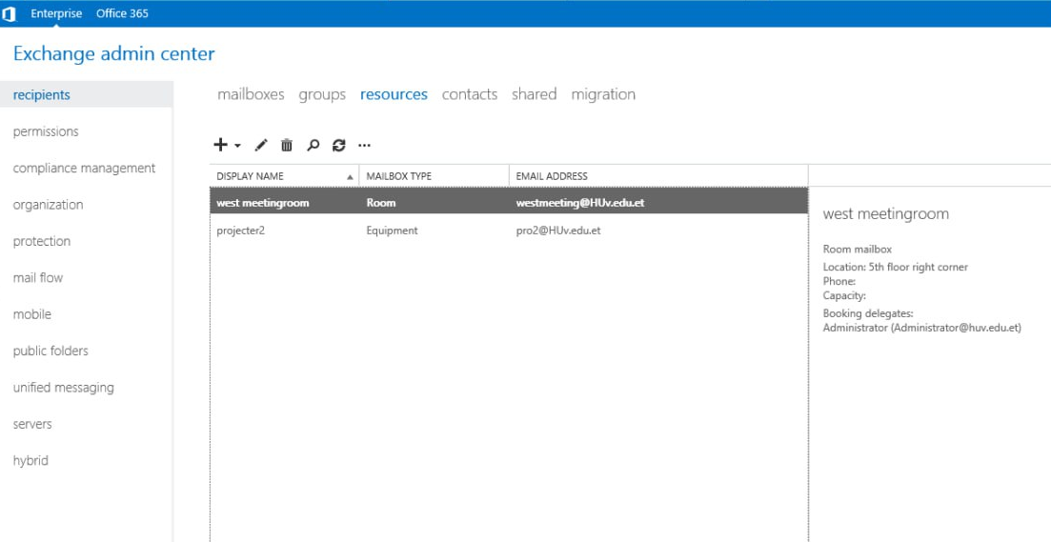
Client Access
32
Resousrse creation
Now you create room mailbox and equipment mailbox.
Notes:
Drag & Drop to add a picture in the placeholder

Slide 35
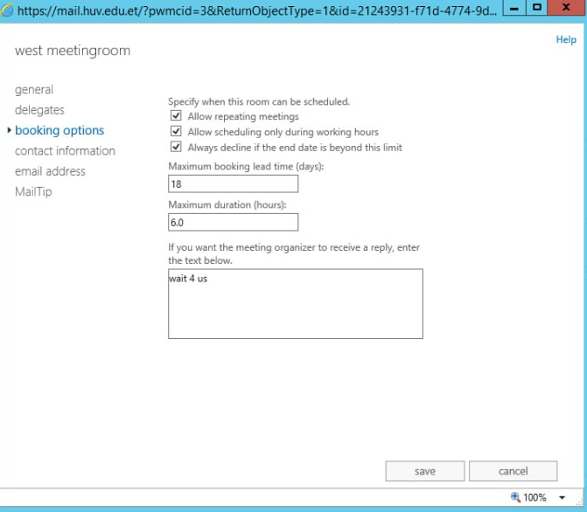
Client Access
33
Booking option configuration
Maximum Booking Lead Time specifies the maximum number of days in advance that a room or resource can be booked.
Notes:
Drag & Drop to add a picture in the placeholder

Slide 36
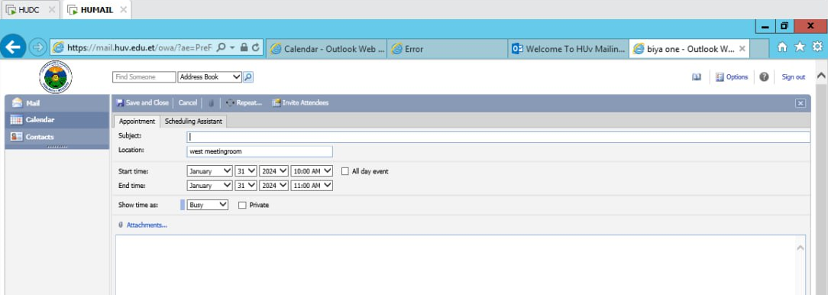
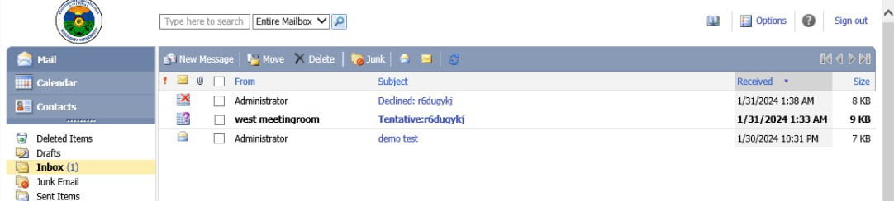
Client Access
34
making Appointment
Notes:
Drag & Drop to add a picture in the placeholder

Slide 37
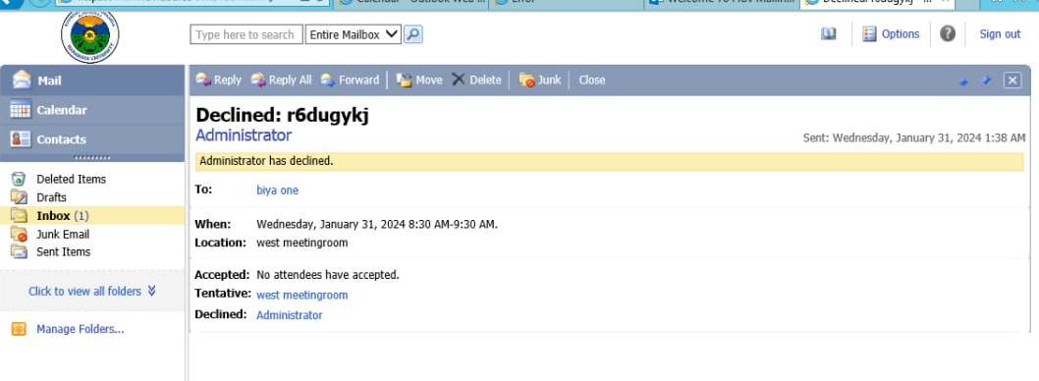
Client Access
35
The Administrator Accepts or Decline the request .
You can also make the system to Accept or Decline the request automatically .
Notes:
Drag & Drop to add a picture in the placeholder

Slide 38
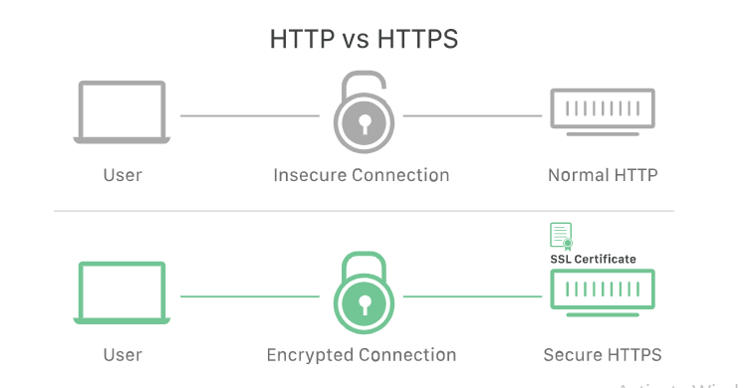
Certificate
36
An SSL certificate is a digital certificate that authenticates a website's identity and enables an encrypted connection.
SSL, or Secure Sockets Layer, is an encryption-based Internet security protocol.
It was first developed by Netscape in 1995 for the purpose of ensuring privacy, authentication, and data integrity in Internet communications.
SSL is the predecessor to the modern TLS encryption used today.
Notes:
Drag & Drop to add a picture in the placeholder

Slide 39
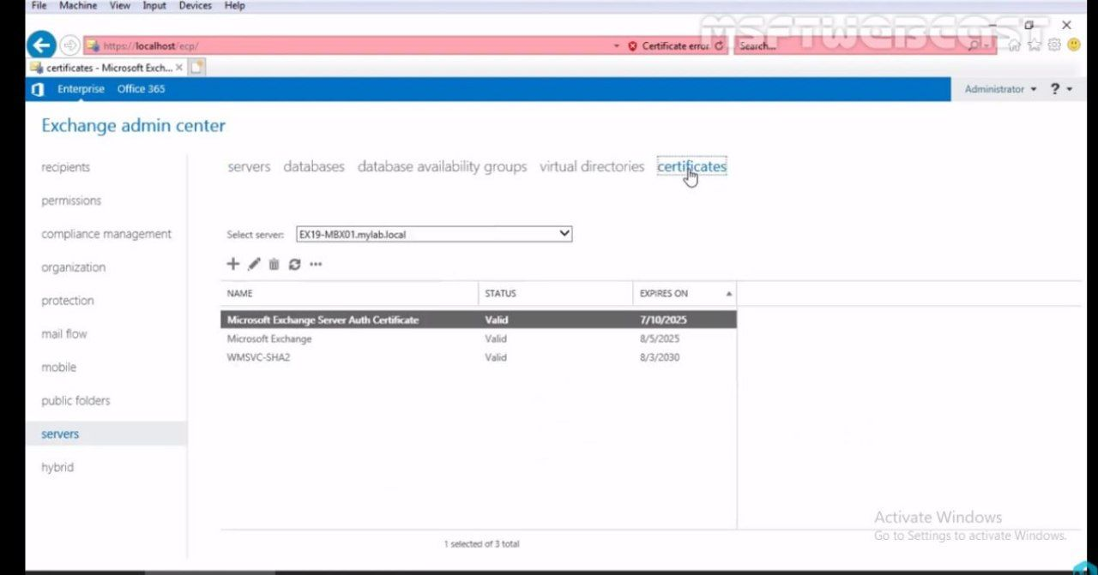
Certificate
37
In Exchange 2013 self-signed certificate are created when we install Exchange server.
But these self-signed certificate are not trusted by other system.
Notes:
Drag & Drop to add a picture in the placeholder

Slide 40
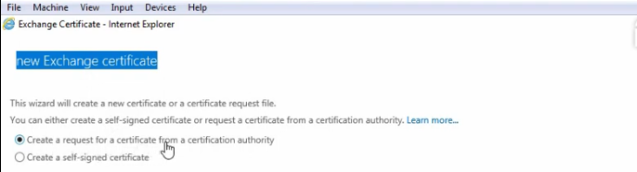
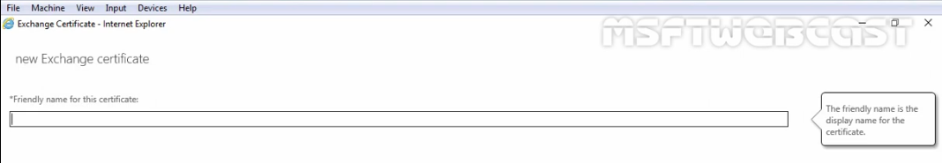
Certificate
38
We will request new certificate from CA
Then will give the name for the certificate
Notes:
Drag & Drop to add a picture in the placeholder

Slide 41
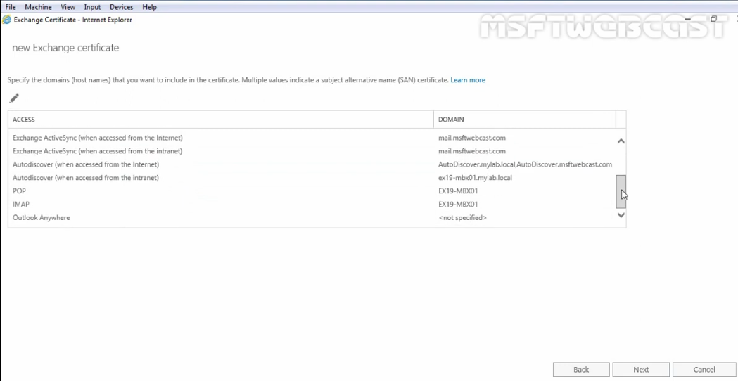
Certificate
39
Then we will specify the domain that we went to include
Notes:
Drag & Drop to add a picture in the placeholder

Slide 42
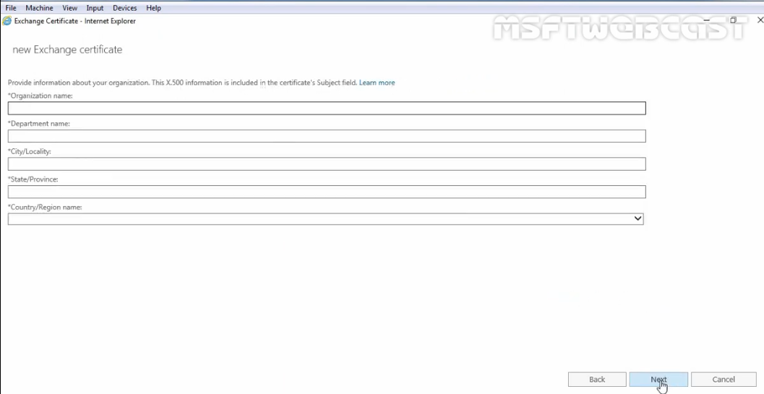
Certificate
40
we specify information about our organization
Notes:
Drag & Drop to add a picture in the placeholder

Slide 43
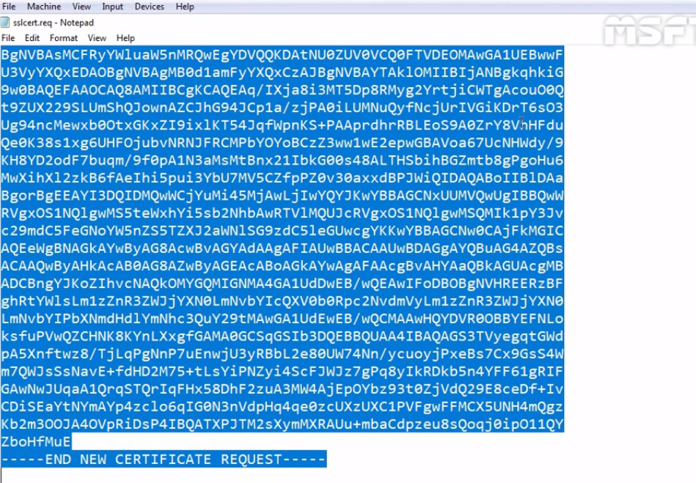
Install & configure SSL Certificate on exchange server .
41
We will send this information to certificate authority to get the cirtificate based on our requirement.
Notes:
Drag & Drop to add a picture in the placeholder

Slide 44
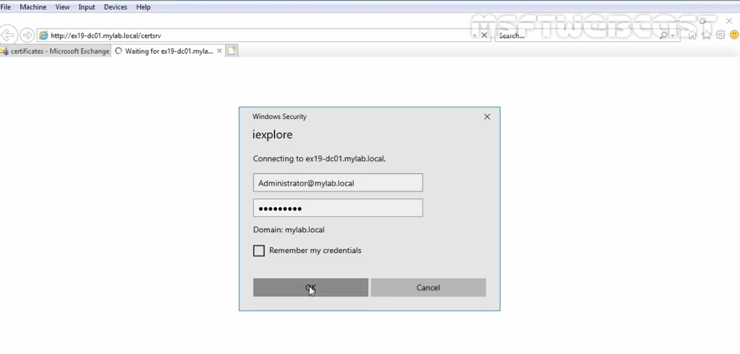
Install & configure SSL Certificate on exchange server .
42
To access enterprise root-certification authority web page we will use url
http://humail.huv.edu.et/certsrv
Notes:
Drag & Drop to add a picture in the placeholder

Slide 45
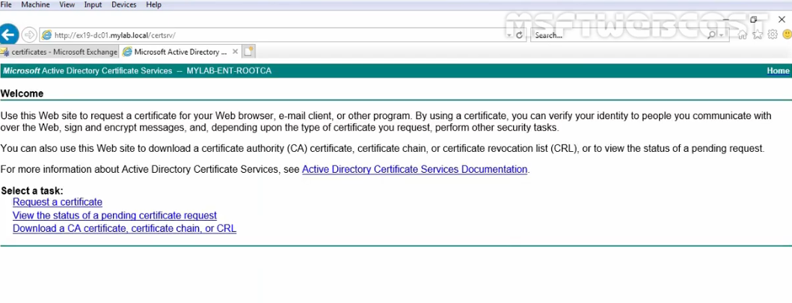
Certificate
43
Notes:
Drag & Drop to add a picture in the placeholder

Slide 46
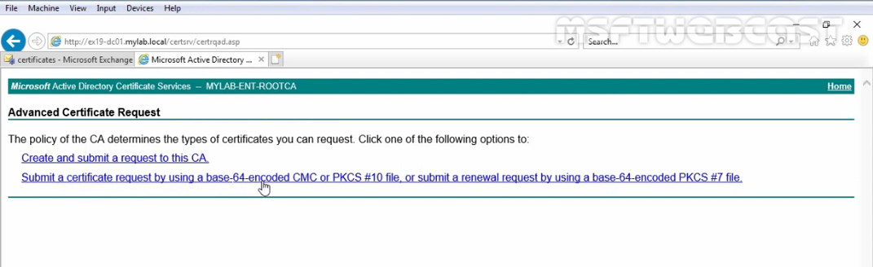
Certificate
44
Notes:
Drag & Drop to add a picture in the placeholder

Slide 47
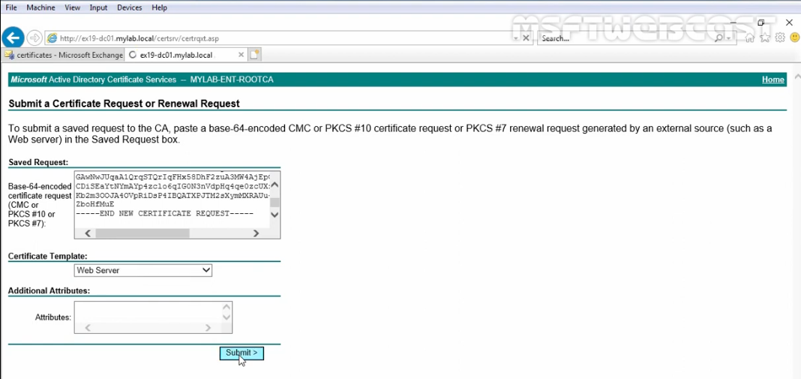
Certificate
45
Notes:
Drag & Drop to add a picture in the placeholder

Slide 48
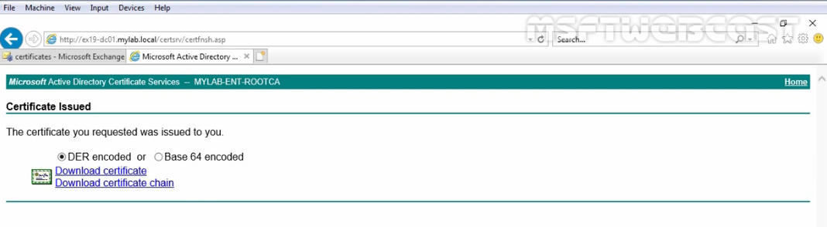
Certificate
46
Based on our request our certificate is issued.
Notes:
Drag & Drop to add a picture in the placeholder

Slide 49
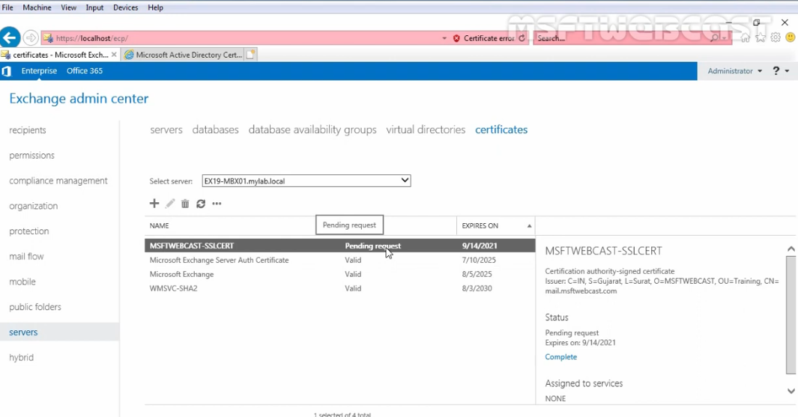
Certificate
47
our certificate is pending we need to install the certificate to complete the request
Notes:
Drag & Drop to add a picture in the placeholder

Slide 50
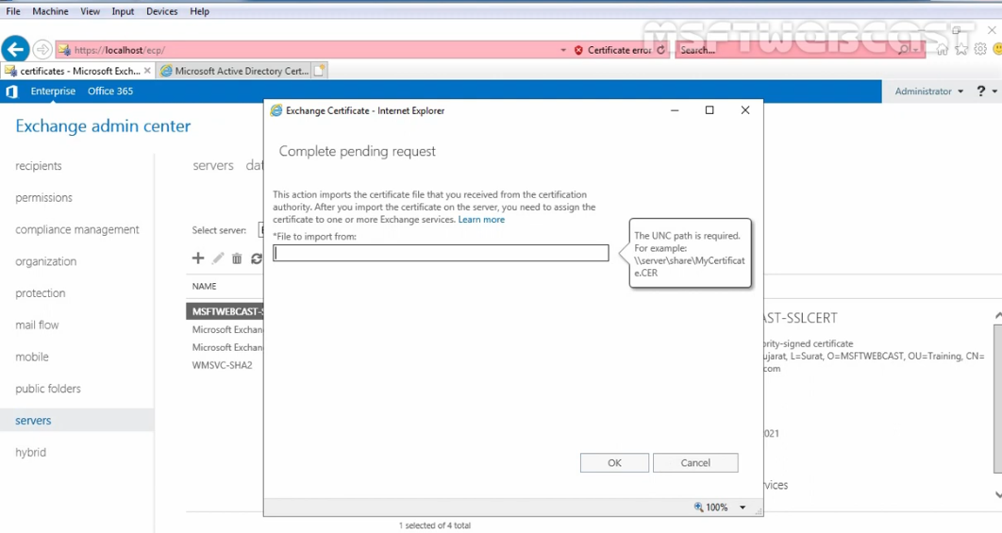
Certificate
48
We will provide the UNC path where we stored the certificate
Notes:
Drag & Drop to add a picture in the placeholder

Slide 51
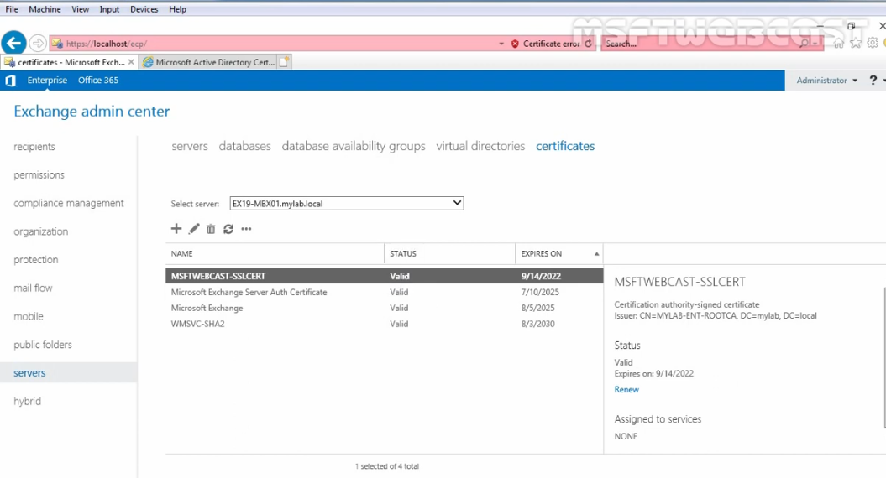
Certificate
49
As we see the status changed to valid
Notes:
Drag & Drop to add a picture in the placeholder

Slide 52
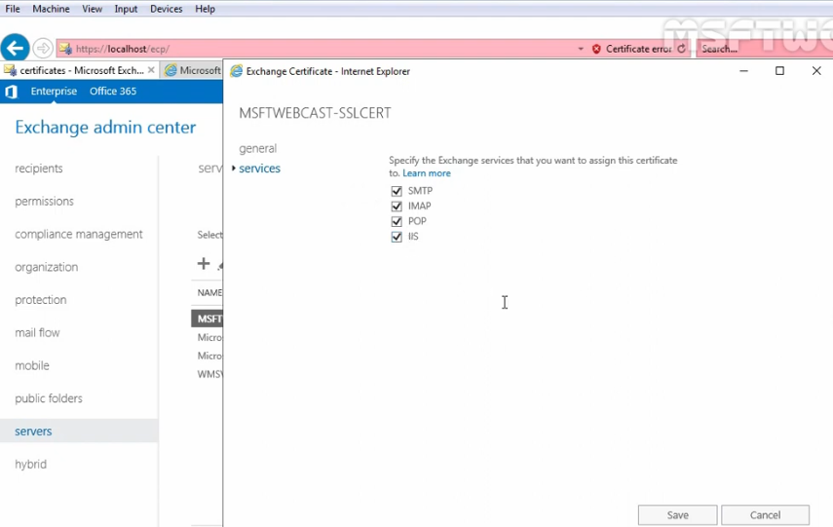
Certificate
50
we will select services which we went to assign the certificate.
Notes:
Drag & Drop to add a picture in the placeholder

Slide 53
Certificate
51
POP3:Is used to receive emails from a remote serer and send to a local client
IMAP:(Internet Message Access Protocol version) Protocol for receiving email that allows users to access their email from different devices.
IIS: plays a crucial role in the functioning of Exchange’s web-based services
SMTP: is a protocol used to send emails on the internet. In the context of Microsoft Exchange Server, SMTP plays a crucial role in the delivery of email messages.
Notes:
Drag & Drop to add a picture in the placeholder

Slide 54
Customization
52
Microsoft Exchange Outlook page is an open source mailing system.
We can customize the Outlook on the web (formerly known as Outlook Web App) sign-in, language selection, and error pages in Exchange Server.
Backup the default Outlook on the web files before you make any changes. Create a back-up copy of your customized files so you can reapply them after a reinstallation or upgrade of the Exchange server.
Customize the color of the Outlook on the web sign-in page: Use Notepad to open the file %ExchangeInstallPath%FrontEnd\HttpProxy\owa\auth\<ExchangeVersion>\themes\resources\logon.css
Customize the Title and Icon on Browers of the Outlook on the web sign-in page: Use Notepad to open the file %ExchangeInstallPath%FrontEnd\HttpProxy\owa\auth\<ExchangeVersion>\themes\resources\logon.apax.
Customize the logo file by replacing image in resource files.
Notes:
Drag & Drop to add a picture in the placeholder

Slide 55
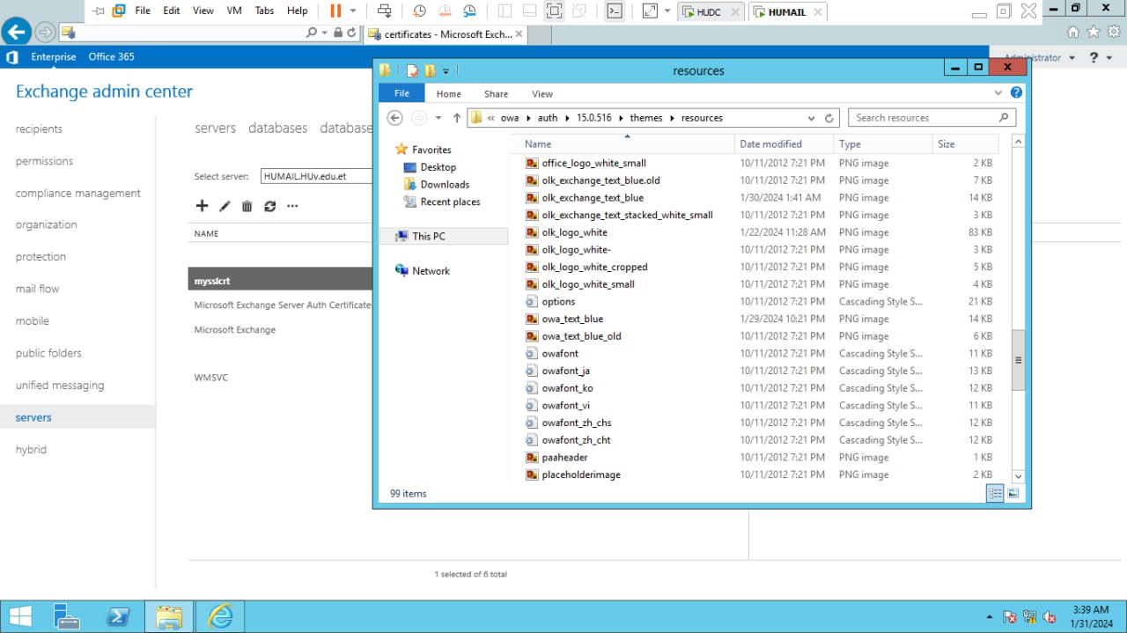
Customization
53
Resource Files
Notes:
Drag & Drop to add a picture in the placeholder

Slide 56

Customization
54
Outlook Owa sign in page customization preview
Notes:
Drag & Drop to add a picture in the placeholder

Slide 57

Customization
55
Outlook ECP sign in page customization preview
Notes:
Drag & Drop to add a picture in the placeholder

Slide 58
Customization
56
Outlook owa message view page customization preview
Notes:
Drag & Drop to add a picture in the placeholder

Slide 59

Customization
57
Outlook owa mobile sign in page customization preview
Notes:
Drag & Drop to add a picture in the placeholder

Slide 60

Customization
58
Outlook owa mobile message view page customization preview.
Notes:
Drag & Drop to add a picture in the placeholder

Slide 61
Customization
59
Customization Recommendations
Language chooser page
Error page
Icon on Browser (Favicon)
Message view Page
Notes:
Drag & Drop to add a picture in the placeholder

Slide 62

THANK
YOU

